Slide 1
Electrical Computers (1940-present)
4 Generations of electrical digital computers

Slide 2
First mechanical-electrical computers

Slide 3
Konrad Zuse’s Z1, Z2, Z3, Z4 (Germany, 1938-1949)
Zuse invented Z1, a mechanical computer in 1938 in his parent’s flat
Never worked due to insufficient mechanical precision
Used 22-bit floating point binary numbers
Read instructions from a tape perforated 35 mm film
Limited programmability (9 instructions; 1 instruction took 1-20 cycles)
An electrical motor gave the clock frequency of 1Hz
Weighted 1000 kg and had mechanical metal parts and a few electrical relays
The design documents were destroyed in 1944 by British bombing

Slide 4
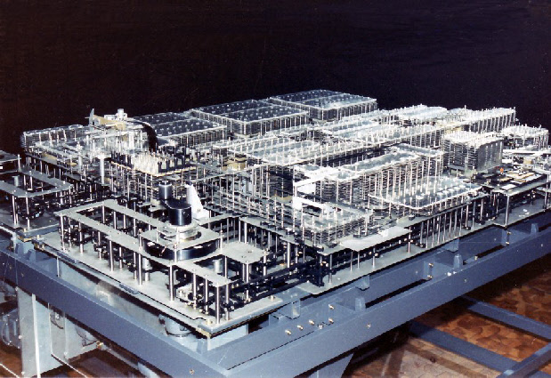
Z1, 1938

Slide 5
Z2, 1939
Similar to Z1, but implemented the arithmetic and control unit using electrical relays
Had the same mechanical memory with 64 words
Used 16-bit floating point arithmetic
Clock frequency of 5Hz
An addition operation took 0.8 seconds
Weighted 300 kg and consumed 1000 watts

Slide 6
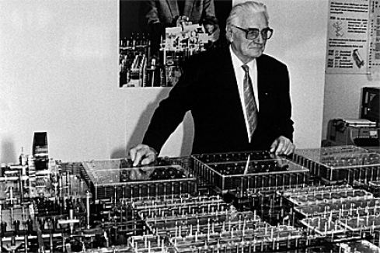
Z2, 1939

Slide 7
Z3, 1941
An electromechanical computer
The world’s first working, programmable digital computer
Used 2000 electrical relays
Had a clock frequency of 5.3Hz
Arithmetic unit: add, substract, multiply, divide, square root 22-bit floating point numbers
Program and data were stored on punched tape film
Was Turing-complete, had loop instructions, but no conditional
Addition took 0.8 seconds, multiplication took 3 seconds
Weighted 1000 kg and consumed 4000 Watts

Slide 8
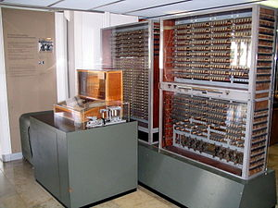
Z3, 1941

Slide 9
Z4, 1945
Zuse realized it is difficult to program in machine code, so he invented a programming language, Plankalkül
Had a frequency of 40Hz
Addition – 400 ms, multiplication – 3 seconds
Input/output on punch tape and programs were written on 35mm punched film
Used 32-bit floating points
Used 2.500 relays
Consumed 4KWatts of power

Slide 10
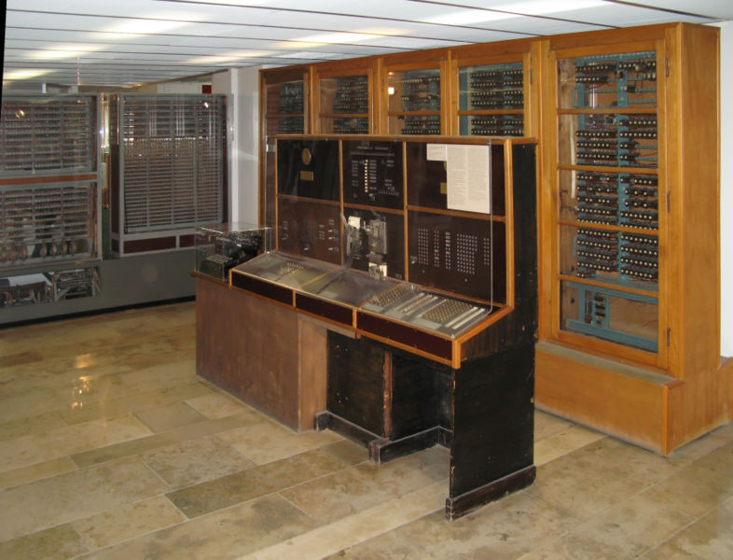
Z4, 1945

Slide 11
First generation computers (based on vacuum tubes): 1940-1960

Slide 12
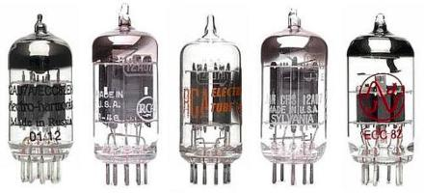
Vacuum tubes

Slide 13
Colossus, UK, 1943-1945
Developed by British codebreakers to break the Lorenz German cipher; used only for decrypting messages
Used vacuum tubes
It was programmed by switches and plugs and not by a stored program
Had no memory, input on paper tape, output – electric type writer

Slide 14
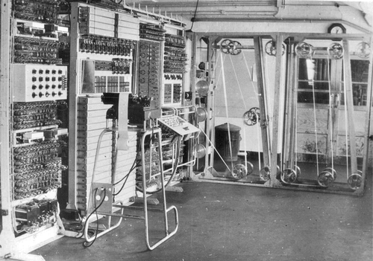
Colossus

Slide 15
ENIAC, US, 1946
A Turing-complete, electrical general-purpose computer
ENIAC = Electronic Numerical Integrator and Computer
Built by John Mauchly and J. Presper Eckert from Univ. Pensylvannia for US Army
Could calculate a bomb trajectory in 30 seconds (a human would do it in 20 hours)
It cost 487.000 $ (equiv. to 6.887.000 $ in today’s money)
contained 20,000 vacuum tubes, 7200 crystal diodes, 1500 relays, 70,000 resistors, 10,000 capacitors and approximately 5,000,000 hand-soldered joints
Weighted 27 tons, occupied 167 squared meters, consumed 150 KWatts of electricity
Input/output on IBM punched cards

Slide 16
ENIAC, US, 1946
Had a 100-word magnetic memory
Could do 385 multiplications / second, 40 divisions / second and 3 square root / second
200 micro second cycles (100KHz)
Could perform complex sequences of operations, including loops, branches, and subroutines but not with stored programs, but with manual switches
Very unreliable, vacuum tubes would break daily – longest runtime approx. 5 days

Slide 17
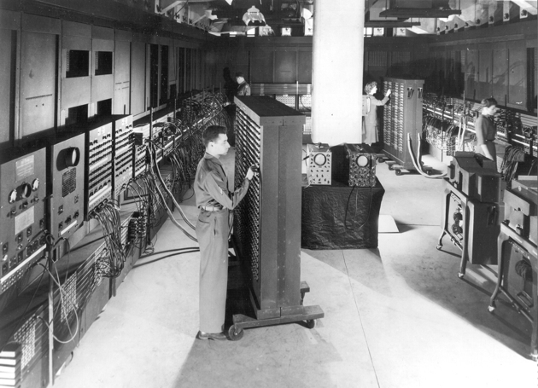
ENIAC

Slide 18
EDVAC, US, 1949
EDVAC = Electronic Discrete Variable Automatic Computer
built by John Mauchly and J. Presper Eckert and John von Neumann for the US Ballistics Research Laboratory
Cost similar to ENIAC (500.000 $)
Used a binary system (not decimal like ENIAC) and stored programs in memory
Could do an addition in 867 micro seconds and a multiplication in 2,9 milliseconds
Had a memory of approx. 5.5 KB
had almost 6,000 vacuum tubes and 12,000 diodes, and consumed 56 kW of power; occupied 45.5 sq. meters, weighted 7,8 tons
Ran 20 hours per day

Slide 19
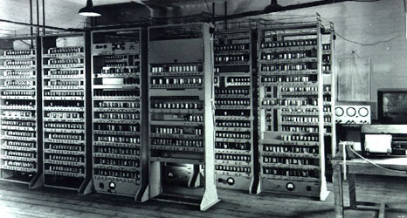
EDVAC

Slide 20
Harvard Mark I-IV, US, 1944 - 1952
IBM Automatic Sequence Controlled Calculator (ASCC)
was built from switches, relays, rotating shafts, and clutches.
It used 765,000 electromechanical components and hundreds of miles of wire
comprising a volume of 23 m³ (16 m x 2.4 m x 0.61 m)
It weighed about 4,500 kg
could do 3 additions or subtractions in a second
a multiplication took 6 seconds, a division took 15.3 seconds, and a logarithm or a trigonometric function took over one minute

Slide 21
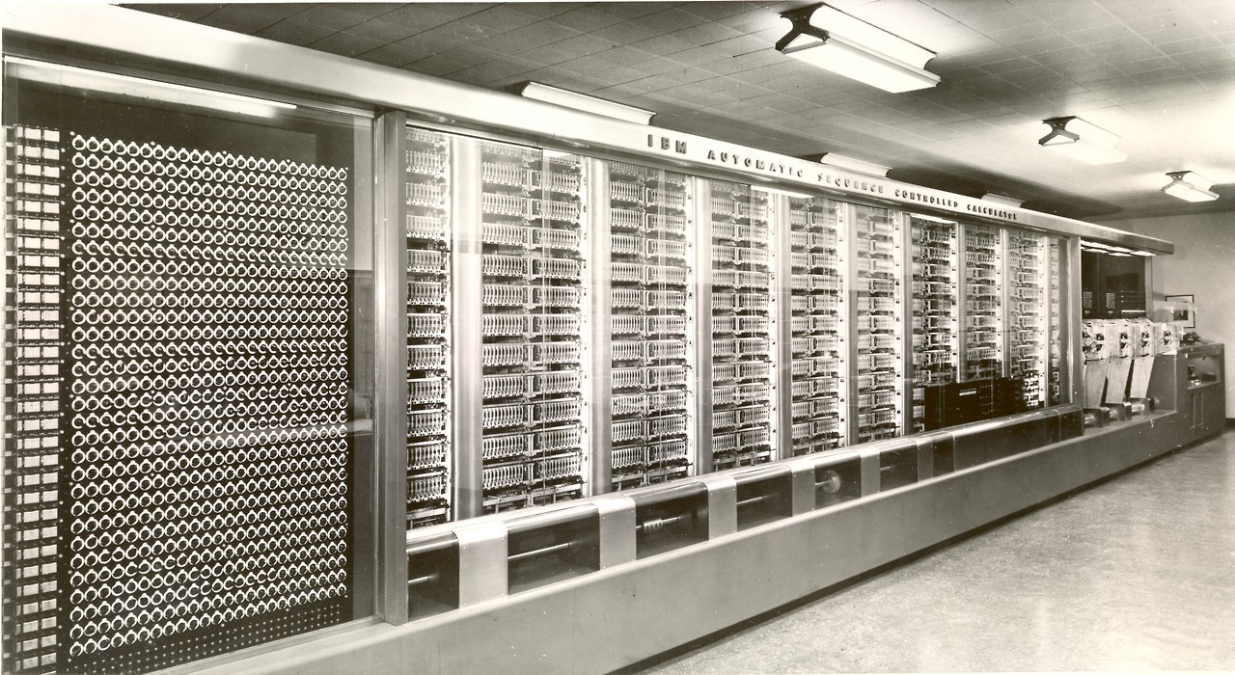
Harvard Mark I

Slide 22
Manchester Mark I, UK, 1948
Developed at the University of Manchester
Consumed 25 Kwatts
Used 40-bit words

Slide 23
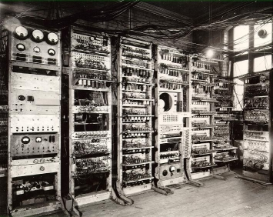
Manchester Mark I

Slide 24
Second generation computers (based on transistors): 1950-1970

Slide 25
Transistors
Invented by John Bardeen, William Shockley and Walter Brattain at Bell Labs, 1948.
Used as an electric amplifier or electronic switch
Transistor Logic gates Adder ALU (Arithmetic and Logic Unit) in a CPU

Slide 26
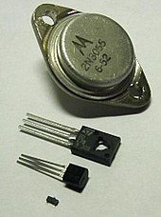
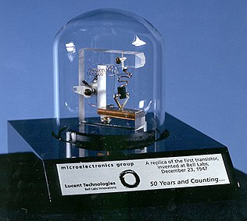
Transistors (2)
Replica of the first working transistor

Slide 27
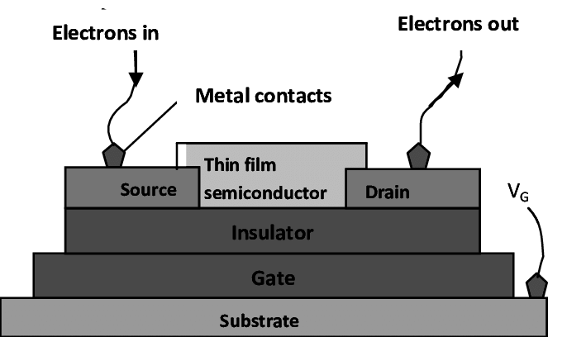
Transistors (3)

Slide 28
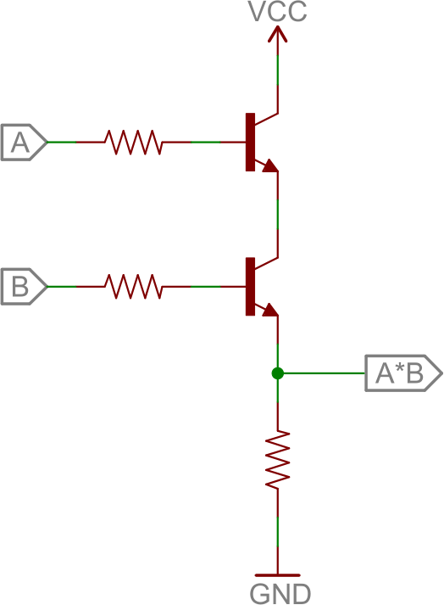
AND logic gate implemented with 2 transistors

Slide 29
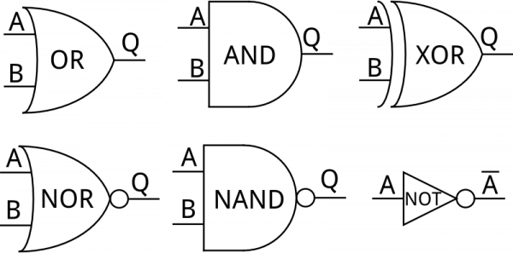
Logic gates

Slide 30
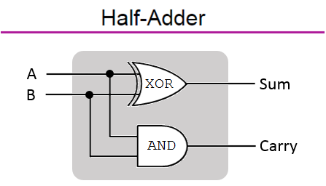
Adder using XOR and AND gates

Slide 31
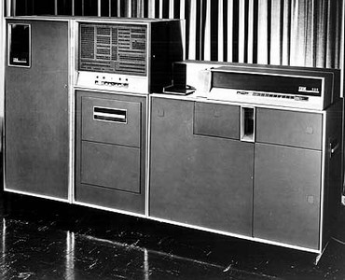
IBM 306, 1957

Slide 32
IBM 306, 1957
Had more than 3000 germanium transistors
Was programmable using an electric control panel
Could store 40 nine-digit numbers in the memory (magnetic core)
it could perform 4,500 additions per second
it could multiply 2 nine-digit numbers, yielding an 18-digit result in 11 milliseconds
it could divide an 18-digit number by a nine-digit number to produce the nine-digit quotient in 13 milliseconds.
was supplied with a type 535 card reader/punch which had its own control plugboard

Slide 33
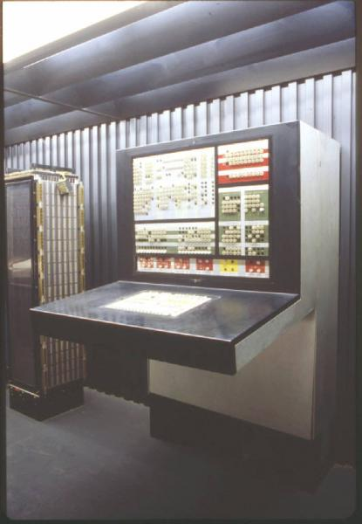
Olivetti Elea 9003, Italy, 1959

Slide 34
Olivetti Elea 9003, Italy, 1959
Run 8-10000 instructions per second
Stored 160.000 words in the memory
Mass storage was on magnetic tape
Input on punched paper tape or punched cards
Output on line printer

Slide 35
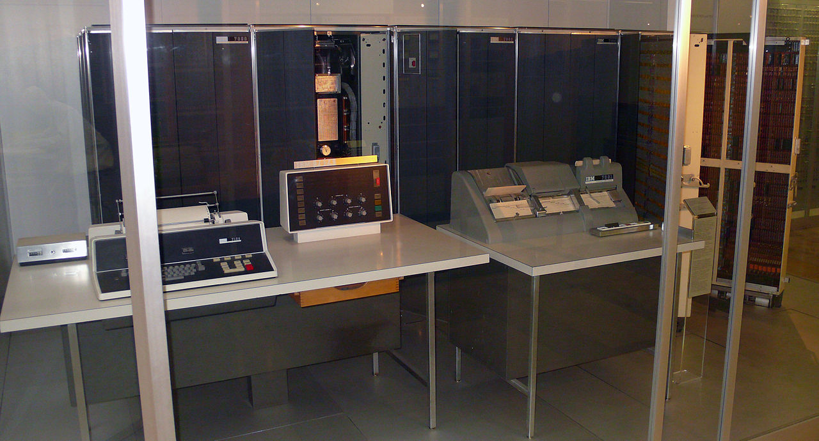
IBM 7007, 1958

Slide 36
IBM 7007, 1958
IBM’s first stored-program computer
CPU speed 27 KIPS
Cost $813.000
Disk storage with a capacity of 6 million digits

Slide 37
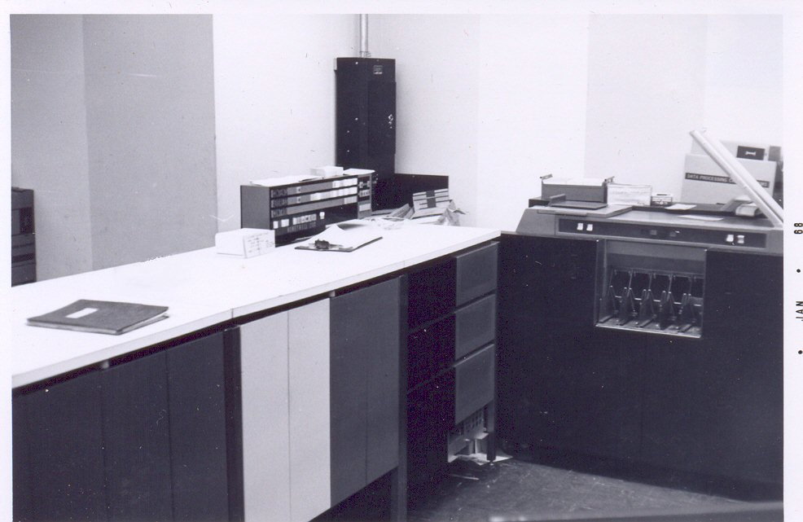
Honeywell 200, US, 1960

Slide 38
Honeywell 200, US, 1960
Used 6-bit characters
Could store 524.288 characters in the main storage
Addition would take 12 useconds
Had COBOL and Fortran compilers

Slide 39
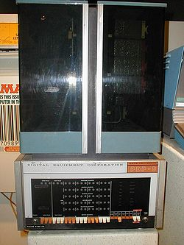
PDP-8, US, 1965

Slide 40
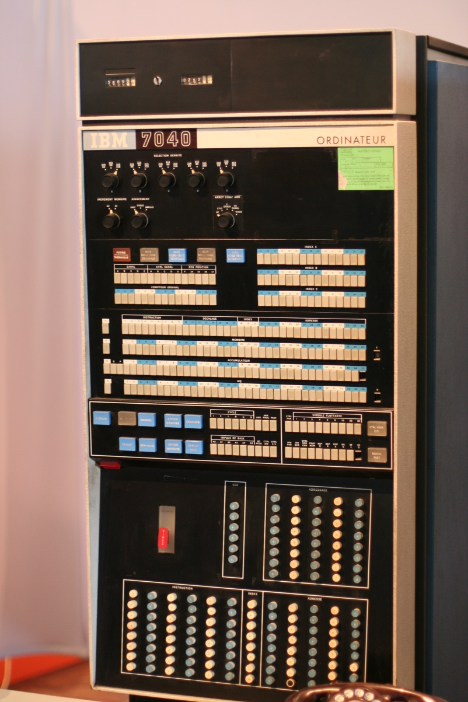
IBM M44/44X, US 1965

Slide 41
IBM M44/44X, US 1965
Was pure experimental, for research
Explored memory paging
Simulated virtual machines

Slide 42
Third generation computers (based on the microchip): 1960-present

Slide 43
The microchip
The integrated circuit (i.e. microchip) was invented independently by Jack Clair Kilby and Robert Noyce
A set of electronic circuits on a small flat piece of semiconductor material, silicon
Integrated many tiny transistors as a one component, instead of linking discrete transistors with wires
Moore’s law: number of transistors in an integrated circuit doubles every two years
As of 2016, typical chip areas range from a few square millimeters to around 600 mm², with up to 25 million transistors per mm²

Slide 44
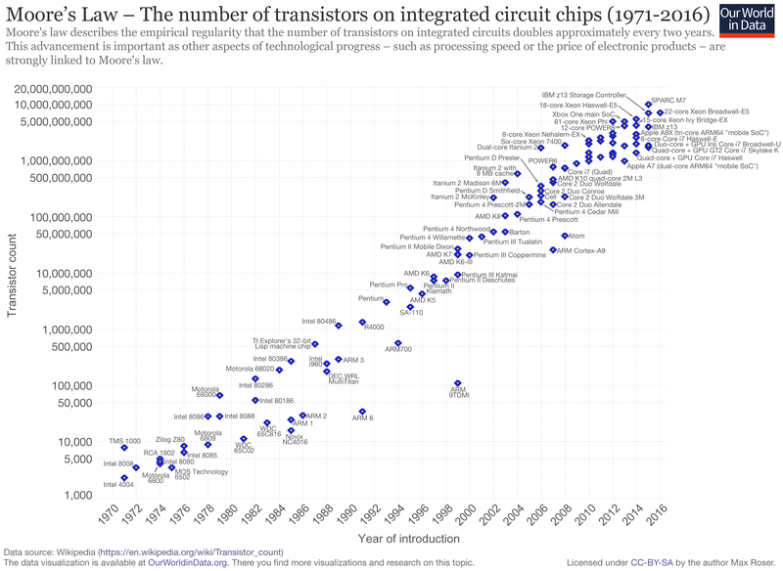
Moore’s law

Slide 45
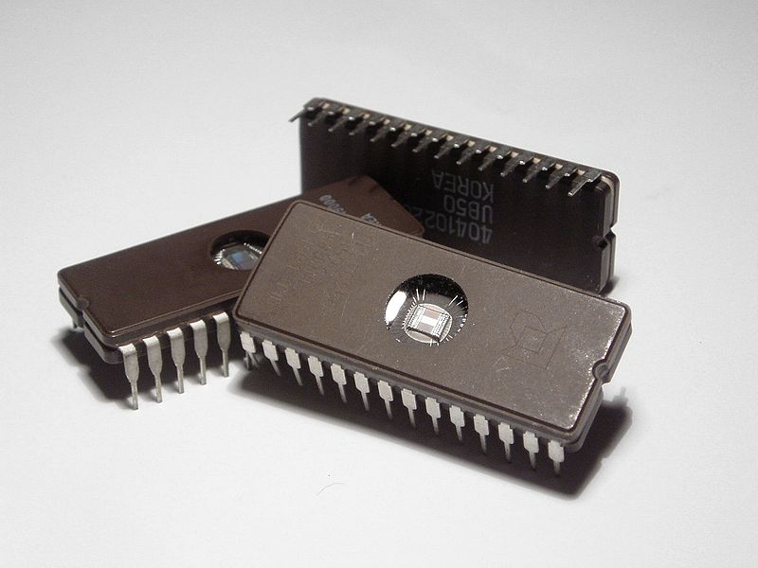
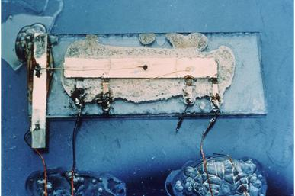
The microchip
Jack Kilby’s original prototype

Slide 46
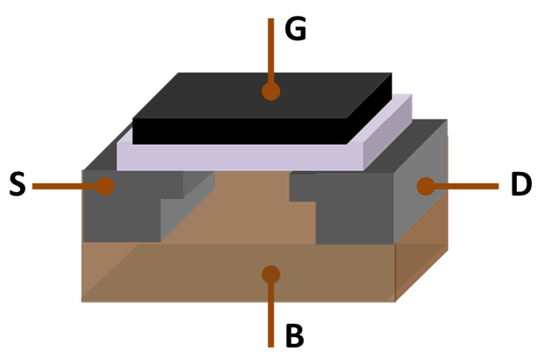
MOSFET (metal-oxide-semiconductor field-effect transistor)
a type of transistor built using silicon
most frequently manufactured electrical component in history
an IC (microchip) contains many mosfets
when there is no electrical current applied to the base B, the current can not pass from S to D, but when there is current applied to base B, electrons can pass from S to D through base B
S = source terminal
D = drain terminal
G = gate (metal)
B = body (the semiconductor made of several layers of silicon)
under the gate G is an insulator plate

Slide 47
Types of microchips
microcontroller (e.g. Atmel Atmega 328p used in Arduino board) – an embedded system on a chip having functions like the ones provided by the CPU, but also including memory, clock component, pins and controllers for external components
microprocessor (CPU, e.g. Intel 4004, 8008, 8086) – a highly specialized microchip having functions like addition, subtraction, multiplication and division of integer numbers and logical bitwise operations

Slide 48
Silicon
a semiconductor material – is between an electrical conductor and an insulator
if it is doped (i.e. treated with chemical substances) or electrical field is applied on it its electrical conductivity can be modified
is the second most frequent element on earth (after oxygen)
is used as the base, substrate for transistors, MOSFETs, integrated circuits

Slide 49
Third generation computers
IBM-360 series
Honeywell-6000 series
IBM-370/168
TDC-316
PDP

Slide 50
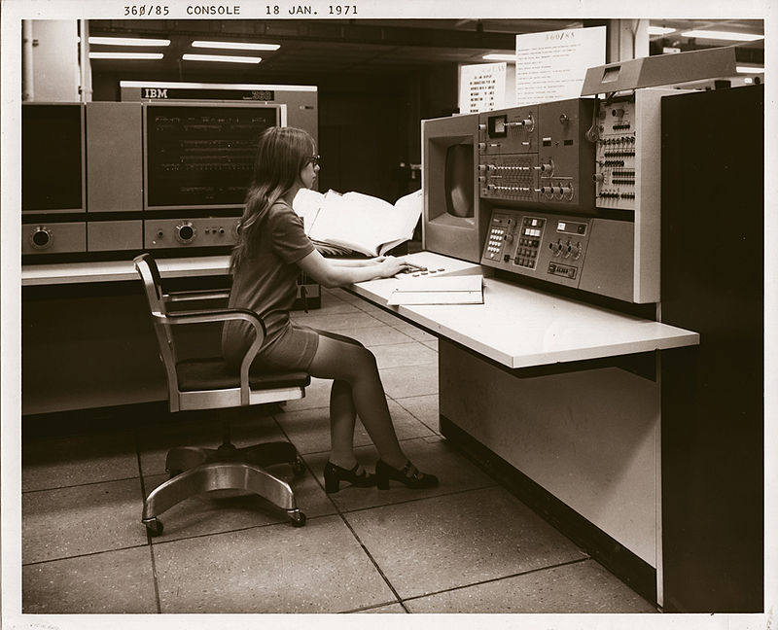
IBM 360 series, model 85 (1968)

Slide 51
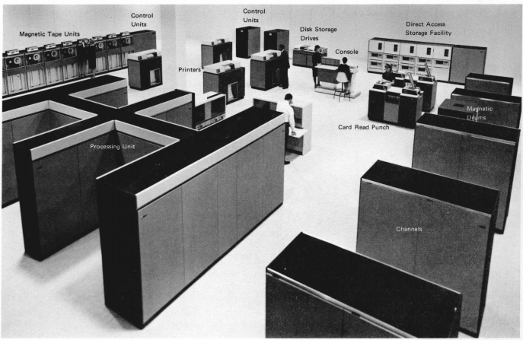
IBM 360 model 85 (cont.)

Slide 52
IBM 360 model 85 (cont.)
Storage: from 500KB to 4MB
major machine-cycle time of 80 ns
main storage data flow is 16 bytes
main storage cycle time is either 960 or 1,040 nanoseconds
operate with floating point numbers with 28 fractional digits

Slide 53
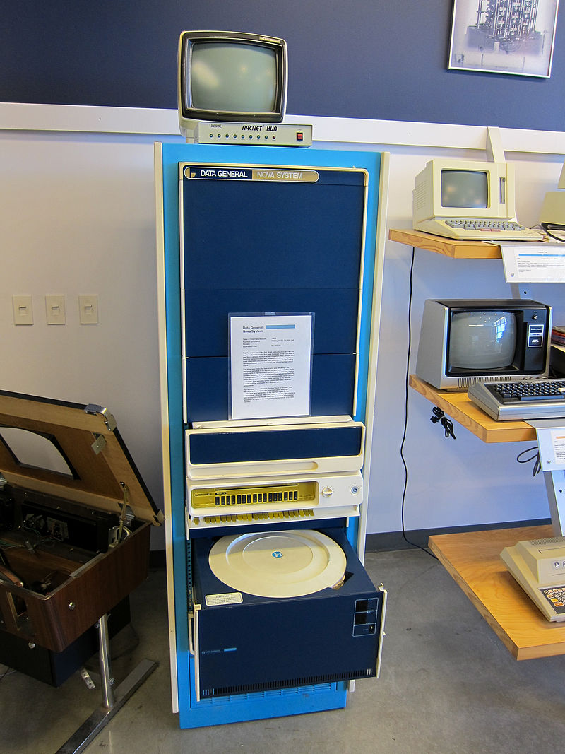
Data General Nova, 1969, 8000$

Slide 54
Fourth generation computers (based on the microprocessor): 1971-present

Slide 55
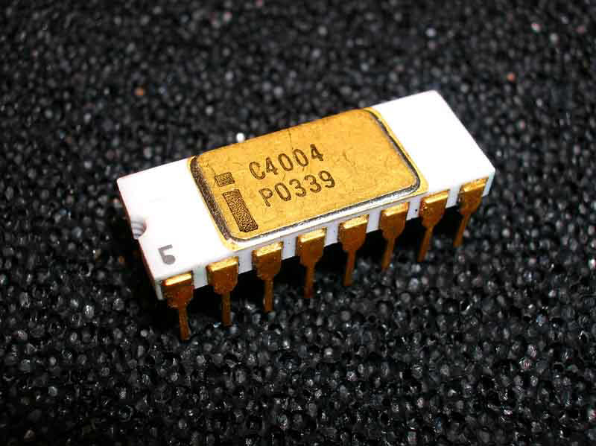
Intel 4004, first microprocessor

Slide 56
Intel 4004
Invented by Intel in 1971
Incorporates CPU functions in a single integrated circuit
microprocessor is a multipurpose, clock driven, register based, digital-integrated circuit which accepts binary data as input, processes it according to instructions stored in its memory, and provides results as output
Operates with binary numbers
Clock frequency 740 KHz
Instruction cycle: 10.8 us

Slide 57
Intel first CPUs
Intel 4004, 1971, first CPU, 4 bits registers
Intel 8008, 1972, 8 bit regs, double the power of 4004
Intel 8080, 1974, 8 bit regs, used for many microcomputers like Altair 8800 (sold thousands in a few months)
Intel 8088, 1978, 8 bit regs, used in IBM-PC
Intel 8086, 1978 – introduced the 16 bit x86 architecture
Intel 80286, 1982, 16 bit regs
Intel 80386, 1985 – introduced the 32-bit comp. architecture (IA-32)
Intel 80486, 1989
Intel Pentium, 1993
Intel Xeon, Pentium 4, 2004 – introduced Intel 64 (x86-64), 64 bit architecture

Slide 58
Microcomputers, Personal Computers

Slide 59
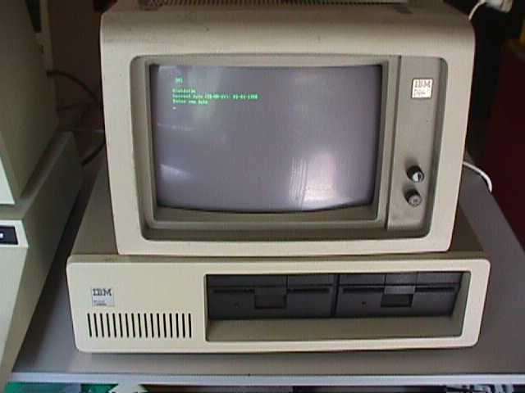
IBM-PC 5150, 1981

Slide 60
IBM-PC 5150, 1981
an important milestone in the evolution of microcomputers for home consumers; most computers produced in the following decades for home users were IBM-PC compatible; modern desktop computers are IBM-PC descendants
costed $1565
used Intel 8088 at 4.7MHz
had a memory 16KB – 640KB
used PC DOS 1.0 OS
storage on 5.25’’ floppy disks or optional hard disk
IBM 5153color display

Slide 61
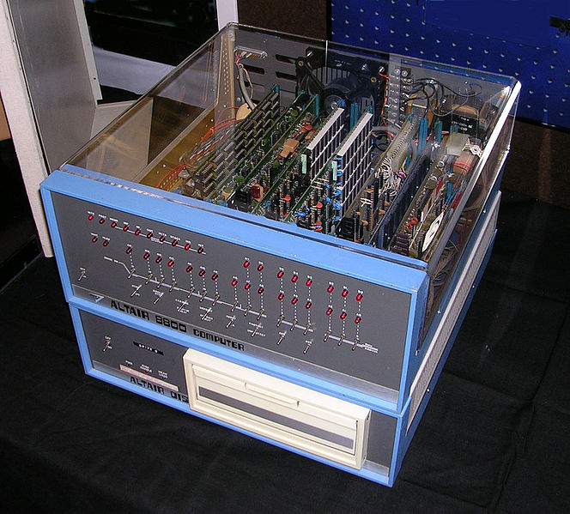
Altair 8800, 1974

Slide 62
Altair 8800, 1974
sold for $395 as a kit and $650 assembled
used Intel 8080 at 2MHz
memory 256 bytes, max 64KB
OS CP/M
storage paper tape, floppy disk, cassette
Links:
http://oldcomputers.net/altair-8800.html
https://www.youtube.com/watch?v=suyiMfzmZKs&ab_channel=deramp5113
https://www.youtube.com/watch?v=EV1ki6LiEmg&ab_channel=deramp5113
https://medium.com/dev-genius/how-to-write-a-program-for-altair-8800-computer-3a4583fe601e

Slide 63
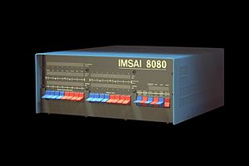
IMSAI 8080, 1975

Slide 64
IMSAI 8080, 1975
sold for $599 as a kit and $931 assembled
used Intel 8080 at 2MHz
supported max 64KB memory
storage on cassette or floppy disks
OS CP/M
machine cycle is 0.5 usec
Links: http://rwebs.net/micros/Imsai/intro.htm

Slide 65
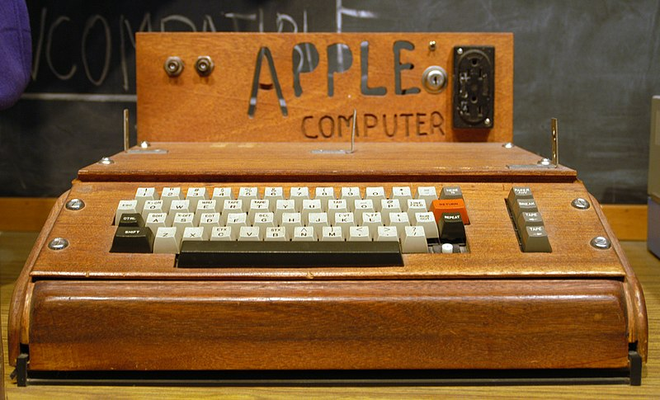
Apple I, 1976

Slide 66
Apple I, 1976
costed $666.66
about 200 were produced
CPU MOS 6502, 1.0 MHz
memory 4K - 64K
monochrome display with resolutions: 280 X 192, 40 X 24 text
Keyboard: not included.
OS Apple BASIC on cassette

Slide 67
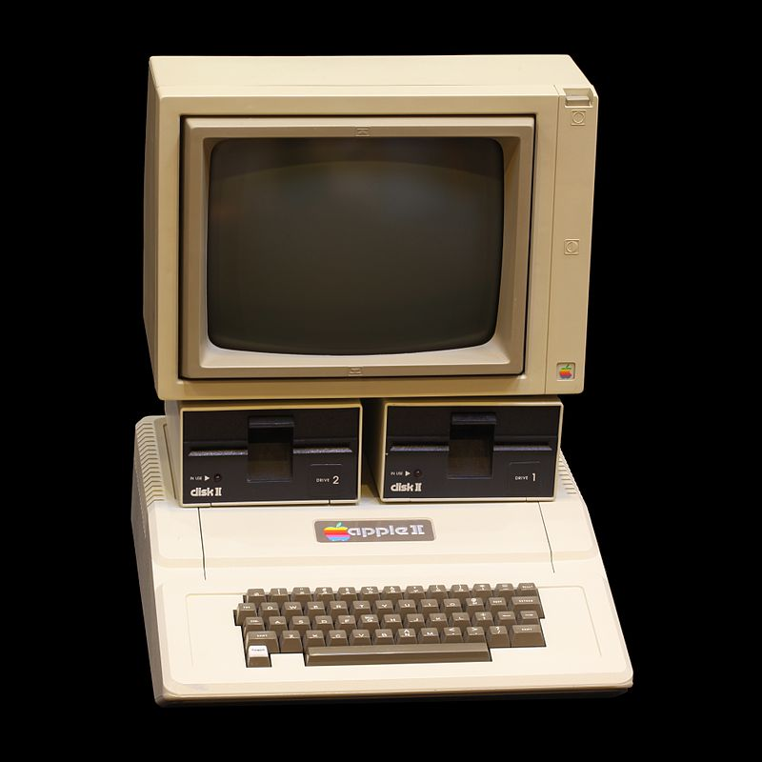
Apple II, 1977

